Slide 1
Chapter 2
The Measurement and Structure of the National Economy

Slide 2
Chapter Outline
National Income Accounting: The Measurement of Production, Income, and Expenditure
Gross Domestic Product
Saving and Wealth
Real GDP, Price Indexes, and Inflation
Interest Rates

Slide 3
National Income Accounting
National income accounts: an accounting framework used in measuring current economic activity
Three alternative approaches give the same measurements
  Product approach: the amount of output produced
  Income approach: the incomes generated by production
  Expenditure approach: the amount of spending by purchasers

Slide 4
National Income Accounting
Juice business example shows that all three approaches are equal
  Important concept in product approach:
  value added = value of output minus value of inputs purchased from other producers

Slide 5
National Income Accounting
Why are the three approaches equivalent?
  They must be, by definition
  Any output produced (product approach) is purchased by someone (expenditure approach) and results in income to someone (income approach)
  The fundamental identity of national income accounting:
total production = total income
= total expenditure (2.1)

Slide 6
Gross Domestic Product
The product approach to measuring GDP
  GDP (gross domestic product) is the market value of final goods and services newly produced within a nation during a fixed period of time

Slide 7
Gross Domestic Product
Market value: allows adding together unlike items by valuing them at their market prices
  Problem: misses nonmarket items such as homemaking, the value of environmental quality, and natural resource depletion
  There is some adjustment to reflect the underground economy
  Government services (that aren’t sold in markets) are valued at their cost of production

Slide 8
Gross Domestic Product
Newly produced: counts only things produced in the given period; excludes things produced earlier

Slide 9
Gross Domestic Product
Final goods and services
  Don’t count intermediate goods and services (those used up in the production of other goods and services in the same period that they themselves were produced)
  Final goods & services are those that are not intermediate
  Capital goods (goods used to produce other goods) are final goods since they aren’t used up in the same period that they are produced

Slide 10
Gross Domestic Product
Final goods and services
  Inventory investment (the amount that inventories of unsold finished goods, goods in process, and raw materials have changed during the period) is also treated as a final good
  Adding up value added works well, since it automatically excludes intermediate goods

Slide 11
Gross Domestic Product
GNP vs. GDP
  GNP (gross national product) = output produced by domestically owned factors of production
  GDP = output produced within a nation
  GDP = GNP – NFP (2.2)
    NFP = net factor payments from abroad
    = payments to domestically owned factors located abroad minus payments to foreign factors located domestically

Slide 12
Gross Domestic Product
GNP vs. GDP
  Example: Engineering revenues for a road built by a U.S. company in Saudi Arabia is part of U.S. GNP (built by a U.S. factor of production), not U.S. GDP, and is part of Saudi GDP (built in Saudi Arabia), not Saudi GNP
  Difference between GNP and GDP is small for the United States, about 0.2%, but higher for countries that have many citizens working abroad

Slide 13
Gross Domestic Product
The expenditure approach to measuring GDP
  Measures total spending on final goods and services produced within a nation during a specified period of time
  Four main categories of spending: consumption (C), investment (I), government purchases of goods and services (G), and net exports (NX)
  Y = C + I + G + NX (2.3)
    the income-expenditure identity

Slide 14
Gross Domestic Product
The expenditure approach to measuring GDP
  Consumption: spending by domestic households on final goods and services (including those produced abroad)
    About 2/3 of U.S. GDP
    Three categories
      Consumer durables (examples: cars, TV sets, furniture, major appliances)
      Nondurable goods (examples: food, clothing, fuel)
      Services (examples: education, health care, financial services, transportation)

Slide 15
Gross Domestic Product
The expenditure approach to measuring GDP
  Investment: spending for new capital goods (fixed investment) plus inventory investment
    About 1/6 of U.S. GDP
    Business (or nonresidential) fixed investment: spending by businesses on structures and equipment and software
    Residential fixed investment: spending on the construction of houses and apartment buildings
    Inventory investment: increases in firms’ inventory holdings

Slide 16
Gross Domestic Product
The expenditure approach to measuring GDP
  Government purchases of goods and services: spending by the government on goods or services
    About 1/5 of U.S. GDP
    Most by state and local governments, not federal government
    Not all government expenditures are purchases of goods and services
      Some are payments that are not made in exchange for current goods and services
      One type is transfers, including Social Security payments, welfare, and unemployment benefits
      Another type is interest payments on the government debt
    Some government spending is for capital goods that add to the nation’s capital stock, such as highways, airports, bridges, and water and sewer systems

Slide 17
Gross Domestic Product
The expenditure approach to measuring GDP
  Net exports: exports minus imports
    Exports: goods produced in the country that are purchased by foreigners
    Imports: goods produced abroad that are purchased by residents in the country
    Imports are subtracted from GDP, as they represent goods produced abroad, and were included in consumption, investment, and government purchases

Slide 18
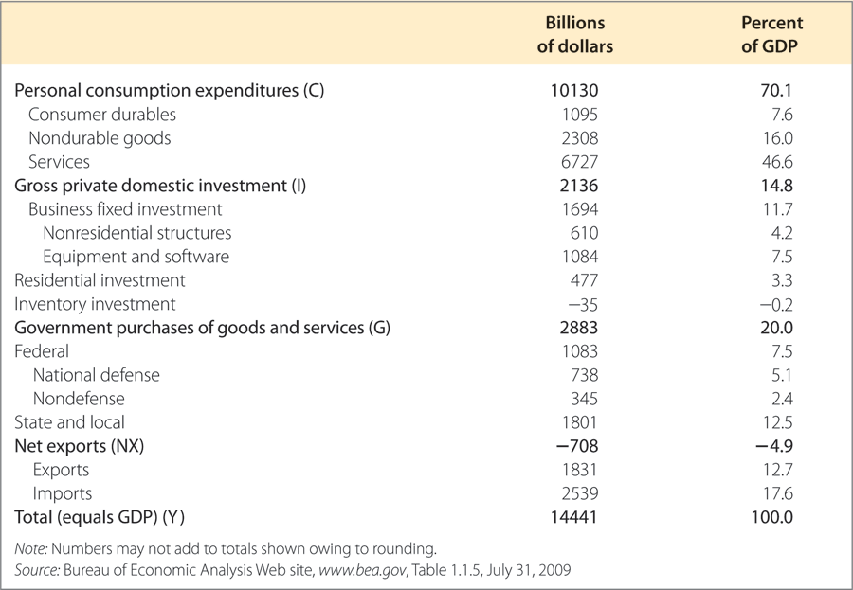
Table 2.1 Expenditure Approach to Measuring GDP in the United States, 2008

Slide 19
Gross Domestic Product
The income approach to measuring GDP
  Adds up income generated by production (including profits and taxes paid to the government)
    National income = compensation of employees (including benefits) + proprietors’ income + rental income of persons + corporate profits + net interest + taxes on production and imports + business current transfer payments + current surplus of government enterprises
    National income + statistical discrepancy = net national product
    Net national product + depreciation (the value of capital that wears out in the period) = gross national product (GNP)
    GNP – net factor payments (NFP) = GDP

Slide 20
Gross Domestic Product
The income approach to measuring GDP
  Private sector and government sector income
    Private disposable income = income of the private sector = private sector income earned at home (Y or GDP) and abroad (NFP) + payments from the government sector (transfers, TR, and interest on government debt, INT) – taxes paid to government (T) = Y + NFP + TR + INT – T (2.4)
    Government’s net income = taxes – transfers – interest payments = T – TR – INT (2.5)
    Private disposable income + government’s net income = GDP + NFP = GNP

Slide 21
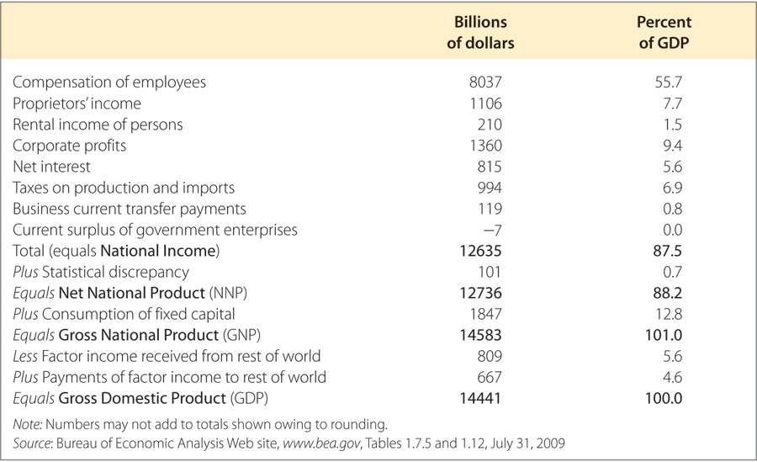
Table 2.2 Income Approach to Measuring GDP in the United States, 2008

Slide 22
Saving and Wealth
Wealth
  Household wealth = a household’s assets minus its liabilities
  National wealth = sum of all households’, firms’, and governments’ wealth within the nation
  Saving by individuals, businesses, and government determine wealth

Slide 23
Saving and Wealth
Measures of aggregate saving
  Saving = current income – current spending
  Saving rate = saving/current income
  Private saving = private disposable income – consumption
  S_{pvt} = (Y + NFP – T + TR + INT) – C (2.6)

Slide 24
Saving and Wealth
Measures of aggregate saving
  Government saving = net government income – government purchases of goods and services
  S_{govt} = (T – TR – INT) – G (2.7)
    Government saving = government budget surplus = government receipts – government outlays
    Government receipts = tax revenue (T)
    Government outlays = government purchases of goods and services (G) + transfers (TR) + interest payments on government debt (INT)
    Government budget deficit = – S_{govt}
    Simplification: count government investment as government purchases, not investment

Slide 25
Saving and Wealth
Measures of aggregate saving
  National saving
    National saving = private saving + government saving
    S = S_{pvt} + S_{govt} (2.8)
    = [Y + NFP – T + TR + INT – C]
    + [T – TR – INT – G]
    = Y + NFP – C – G = GNP – C – G

Slide 26
Saving and Wealth
The uses of private saving
  S = I + (NX + NFP) (2.9)
  S = I + CA (2.10)
  Derived from S = Y + NFP – C – G and Y = C + I + G + NX
  CA = NX + NFP = current account balance

Slide 27
Saving and Wealth
The uses of private saving
  S_{pvt} = I + (–S_{govt}) + CA (2.11)
  (using S = S_{pvt} + S_{govt})
  The uses-of-saving identity—saving is used in three ways:
    investment (I)
    government budget deficit (–S_{govt})
    current account balance (CA)

Slide 28
Saving and Wealth
Relating saving and wealth
  Stocks and flows
    Flow variables: measured per unit of time (GDP, income, saving, investment)
    Stock variables: measured at a point in time (quantity of money, value of houses, capital stock)
    Flow variables often equal rates of change of stock variables
  Wealth and saving as stock and flow (wealth is a stock, saving is a flow)

Slide 29
Saving and Wealth
Relating saving and wealth
  National wealth: domestic physical assets + net foreign assets
    Country’s domestic physical assets (capital goods and land)
    Country’s net foreign assets = foreign assets (foreign stocks, bonds, and capital goods owned by domestic residents) minus foreign liabilities (domestic stocks, bonds, and capital goods owned by foreigners)
    Wealth matters because the economic well-being of a country depends on it

Slide 30
Saving and Wealth
Relating saving and wealth
  National wealth: domestic physical assets + net foreign assets
    Changes in national wealth
      Change in value of existing assets and liabilities (change in price of financial assets, or depreciation of capital goods)
      National saving (S = I + CA) raises wealth
    Comparison of U.S. saving and investment with other countries
      The United States is a low-saving country; Japan is a high-saving country
      U.S. investment exceeds U.S. saving, so we have a negative current-account balance

Slide 31
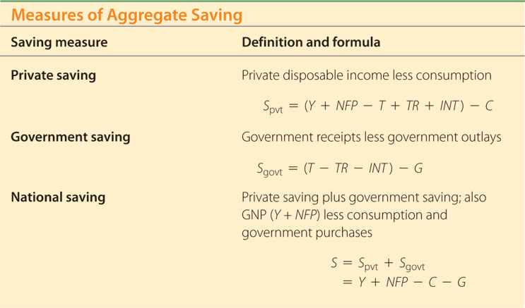
Summary 1 Measures of the Aggregate Savings

Slide 32
Real GDP, Price Indexes, and Inflation
Real GDP
  Nominal variables are those in dollar terms
  Problem: Do changes in nominal values reflect changes in prices or quantities?
  Real variables: adjust for price changes; reflect only quantity changes

Slide 33
Real GDP, Price Indexes, and Inflation
Real GDP
  Example of computers and bicycles
  Nominal GDP is the dollar value of an economy’s final output measured at current market prices
  Real GDP is an estimate of the value of an economy’s final output, adjusting for changes in the overall price level

Slide 34
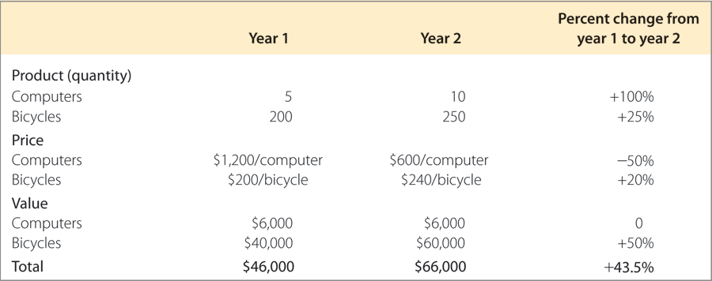
Table 2.3 Production and Price Data

Slide 35
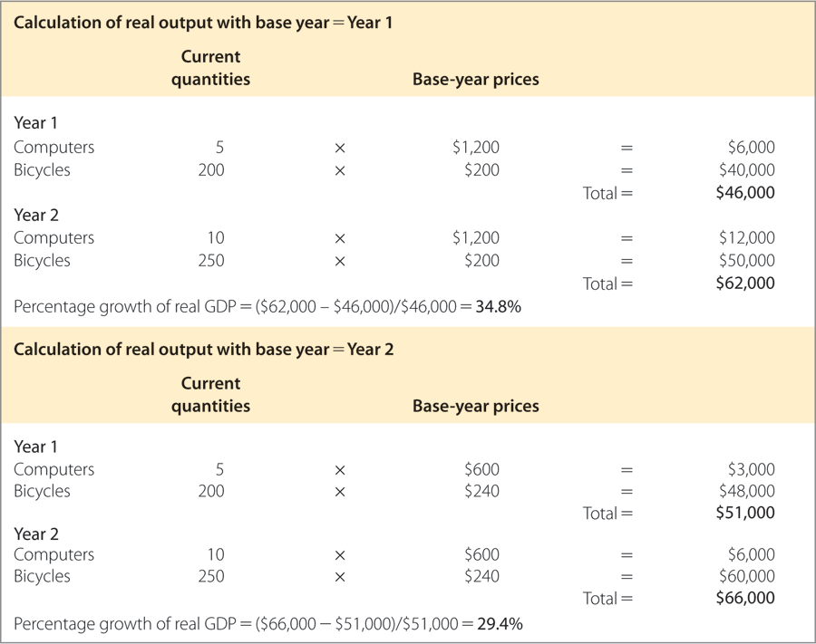
Table 2.4 Calculation of Real Output with Alternative Base Years

Slide 36
Real GDP, Price Indexes, and Inflation
Price Indexes
  A price index measures the average level of prices for some specified set of goods and services, relative to the prices in a specified base year
  GDP deflator = 100 × nominal GDP/real GDP
  Note that base year P = 100

Slide 37
Real GDP, Price Indexes, and Inflation
Price Indexes
  Consumer Price Index (CPI)
    Monthly index of consumer prices; index averages 100 in reference base period (1982 to 1984)
    Based on basket of goods in expenditure base period (2005 to 2006)

Slide 38
Real GDP, Price Indexes, and Inflation
Price Indexes
  The computer revolution and chain-weighted GDP
    Choice of expenditure base period matters for GDP when prices and quantities of a good, such as computers, are changing rapidly
    BEA compromised by developing chain-weighted GDP
    Now, however, components of real GDP don’t add up to real GDP, but discrepancy is usually small

Slide 39
Real GDP, Price Indexes, and Inflation
Price Indexes
  Inflation
    Calculate inflation rate:
  π_{t+1} = (P_{t+1} – P_{t})/P_{t} = ΔP_{t+1}/P_{t}
    Text Fig. 2.1 shows the U.S. inflation rate since 1960 for the GDP deflator

Slide 40
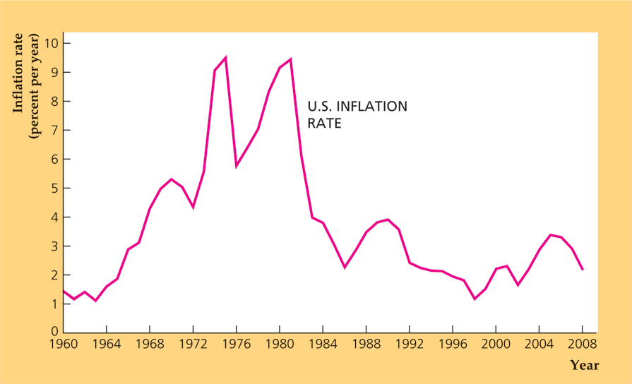
Figure 2.1 The Inflation Rate in the United States, 1960-2008
Source: Implicit price deflator for GDP, from FRED database, Federal Reserve Bank of St. Louis, research.stlouisfed.org/fred2/series/GDPCTPI.

Slide 41
Real GDP, Price Indexes, and Inflation
Price Indexes
  Does CPI inflation overstate increases in the cost of living?
    The Boskin Commission reported that the CPI was biased upwards by as much as one to two percentage points per year
    One problem is that adjusting the price measures for changes in the quality of goods is very difficult

Slide 42
Real GDP, Price Indexes, and Inflation
Price Indexes
  Does CPI inflation overstate increases in the cost of living?
    Price indexes with fixed sets of goods don’t reflect substitution by consumers when one good becomes relatively cheaper than another
      This problem is known as substitution bias

Slide 43
Real GDP, Price Indexes, and Inflation
Price Indexes
  Does CPI inflation overstate increases in the cost of living?
    If inflation is overstated, then real incomes are higher than we thought and we’ve overindexed payments like Social Security
    Latest research suggests bias is still 1% per year or higher

Slide 44
Real GDP, Price Indexes, and Inflation
Application: The Fed’s preferred inflation measures
  The Federal Reserve focuses its attention on the personal consumption expenditures (PCE) price index
    The Fed forecasts both the overall PCE price index and the core PCE price index
  The PCE price index is superior to the CPI because it avoids substitution bias and is revised when better data are available
  Differences between the PCE price index and the CPI include formulas used in their calculation, coverage of different items, and weights given to different items

Slide 45
Real GDP, Price Indexes, and Inflation
Application: The Fed’s preferred inflation measures
  The Fed uses the core PCE price index to measure the underlying trend in inflation
  But the Fed forecasts both the core and overall PCE price index because the Fed needs to keep its eye on both underlying trends but also the actual inflation rate faced by households
  The inflation rate in the overall PCE price index tends to revert to the core measure after a period when the two measures deviate (Figure 2.2)

Slide 46
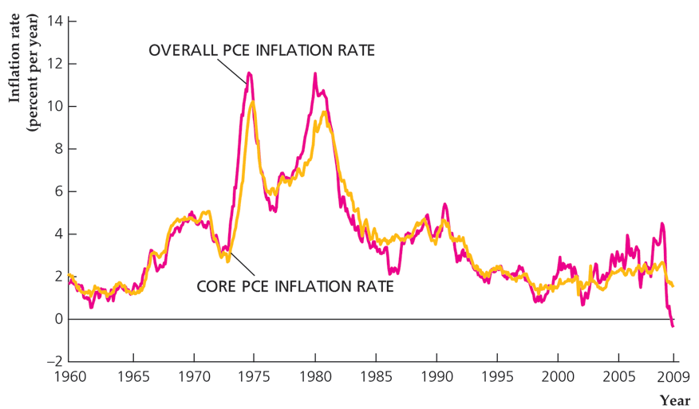
Figure 2.2 Overall PCE inflation rate and core PCE inflation rate, 1960-2008
Source: Federal Reserve Bank of St. Louis FRED database at
research.stlouisfed.org/fred2/series/PCEPI and PCEPILFE.

Slide 47
Interest Rates
Real vs. nominal interest rates
  Interest rate: a rate of return promised by a borrower to a lender
  Real interest rate: rate at which the real value of an asset increases over time
  Nominal interest rate: rate at which the nominal value of an asset increases over time

Slide 48
Interest Rates
Real vs. nominal interest rates
  Real interest rate = i – π (2.12)
  Text Fig. 2.3 plots nominal and real interest rates for the United States since 1960

Slide 49
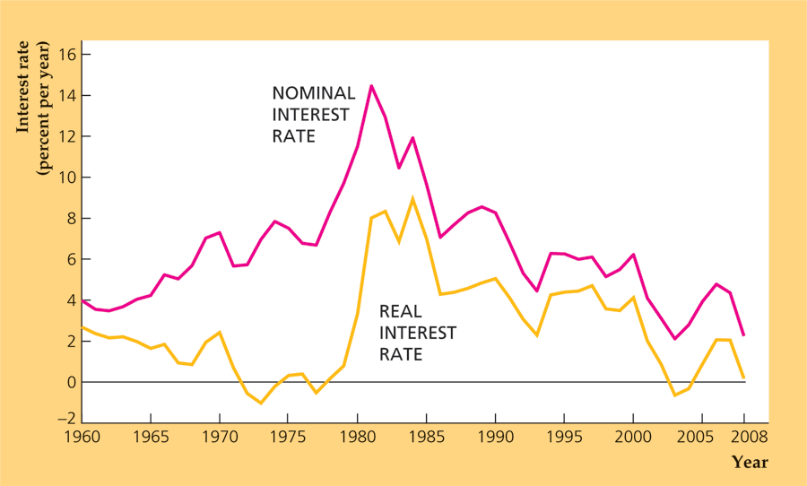
Figure 2.3 Nominal and real interest rates in the United States, 1960-2008
Source: The implicit price deflator for GDP is the same as for Fig. 2.1. Inflation rates for 2009 and 2010 are assumed to be 2%. The nominal interest rate on three-year Treasury securities is from the Board of Governors of the Federal Reserve System, Statistical Release H15, www.federalreserve.gov/releases.

Slide 50
Interest Rates
The expected real interest rate
  r = i – π^{e} (2.13)
  If π = π^{e}, real interest rate = expected real interest rate

